Slide 1
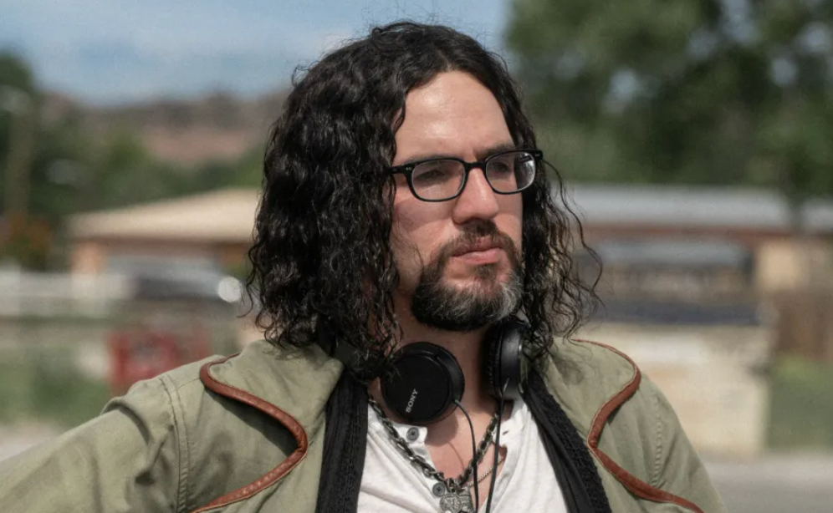
Notes:
Benny Safdie

Slide 2
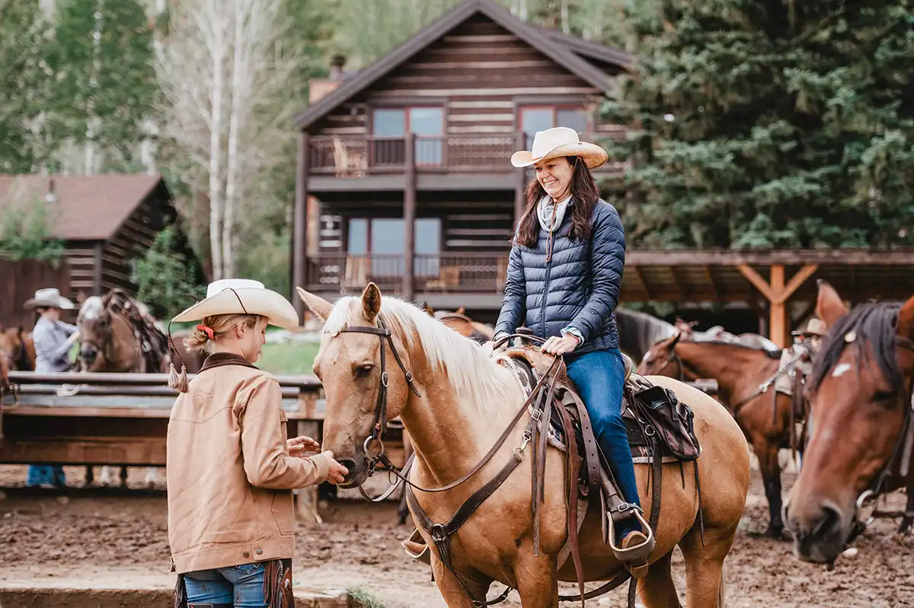
Notes:
Horseback riding

Slide 3

Notes:
The Rehearsal

Slide 4

Notes:
Starbucks

Slide 5

Notes:
How to with John Wilson

Slide 6
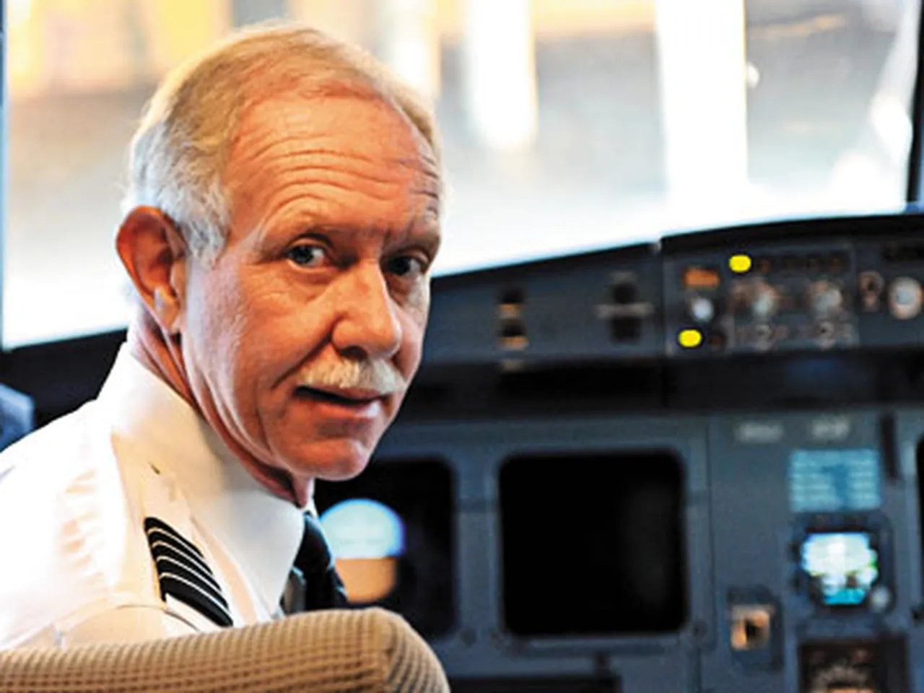
Notes:
Sully Sullenberger

Slide 7


Slide 8
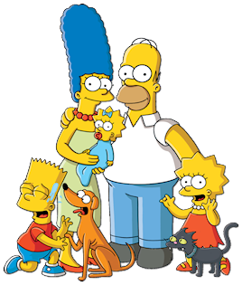
Notes:
The Simpsons

Slide 9
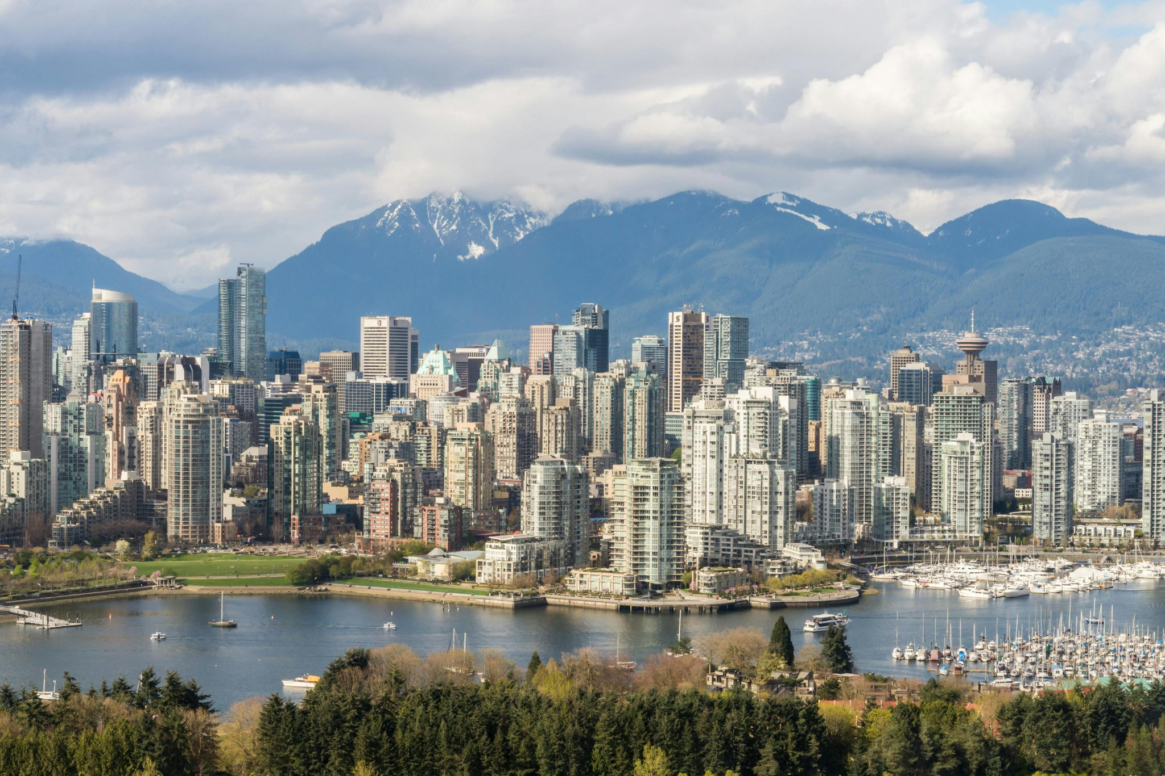
Notes:
Vancouver

Slide 10
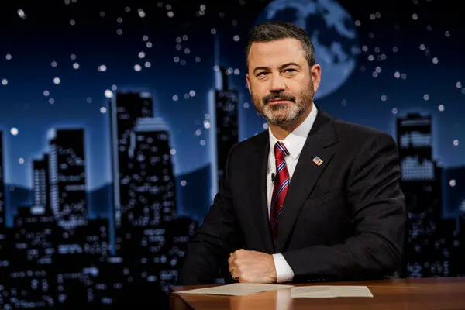
Notes:
Jimmy Kimmel

Slide 11
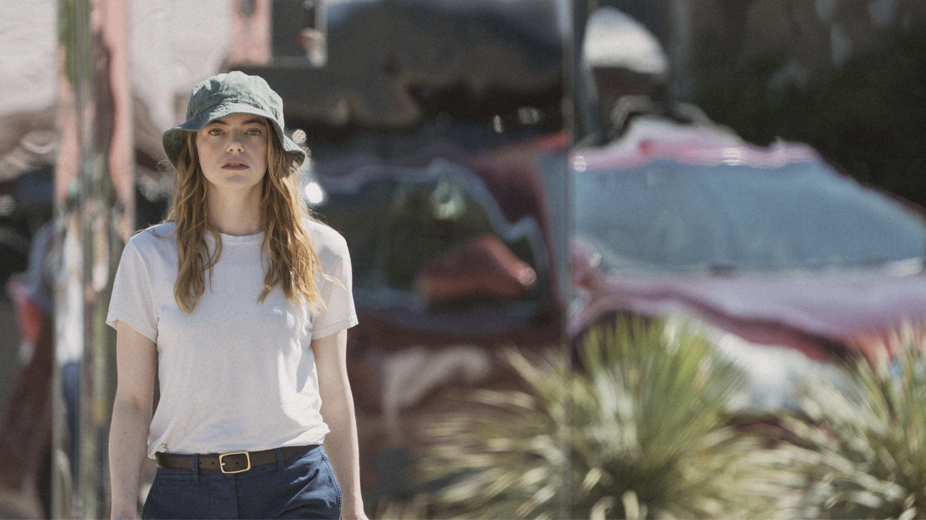
Notes:
Emma Stone

Slide 12

Notes:
The Hunk

Slide 13
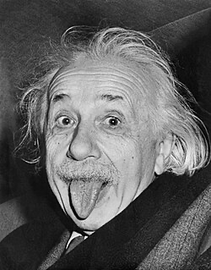
Notes:
Albert Einstein

Slide 14
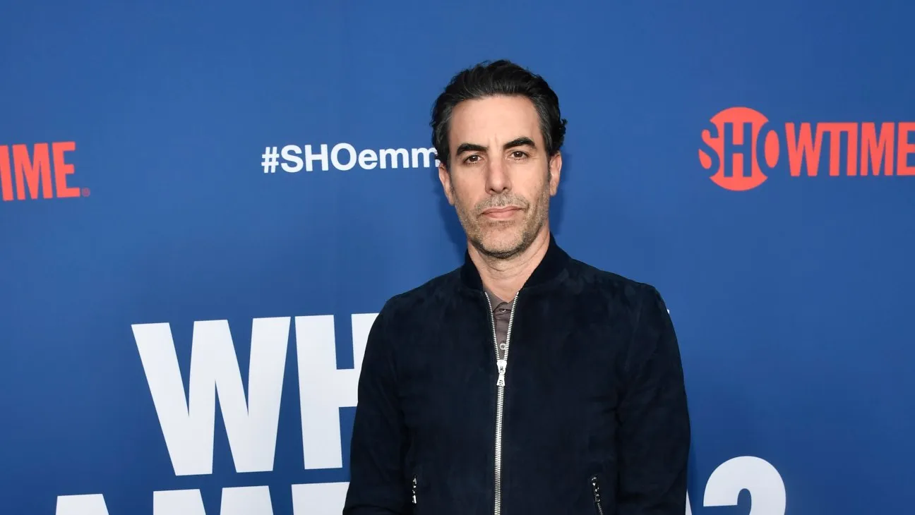
Notes:
Sacha Baron Cohen

Slide 15
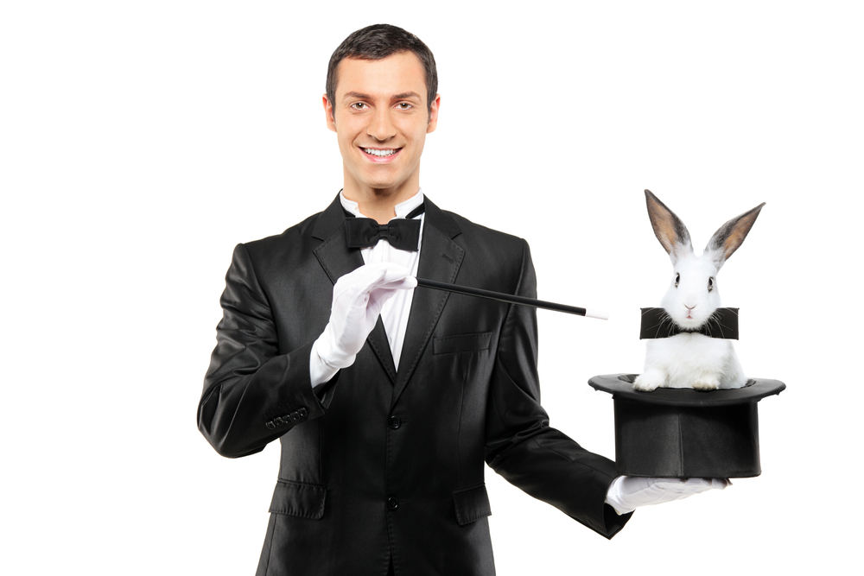
Notes:
Magician

Slide 16
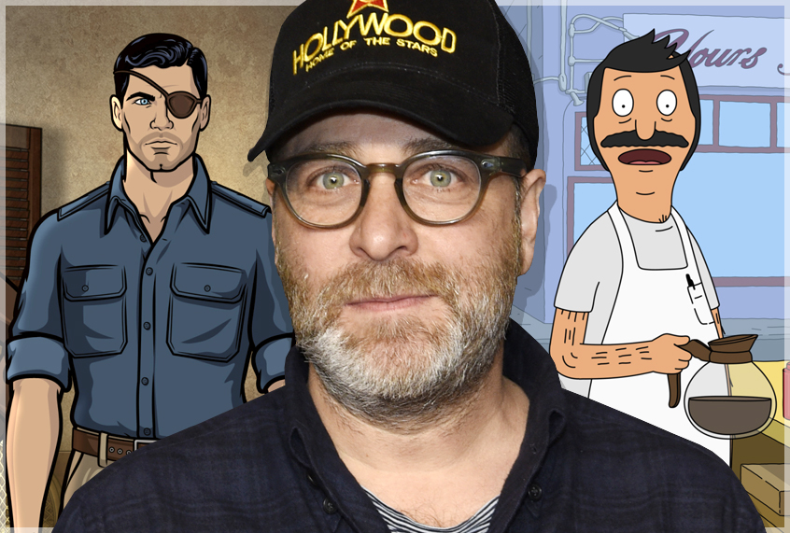
Notes:
H Jon Benjamin

Slide 17

Notes:
Canucks

Slide 18
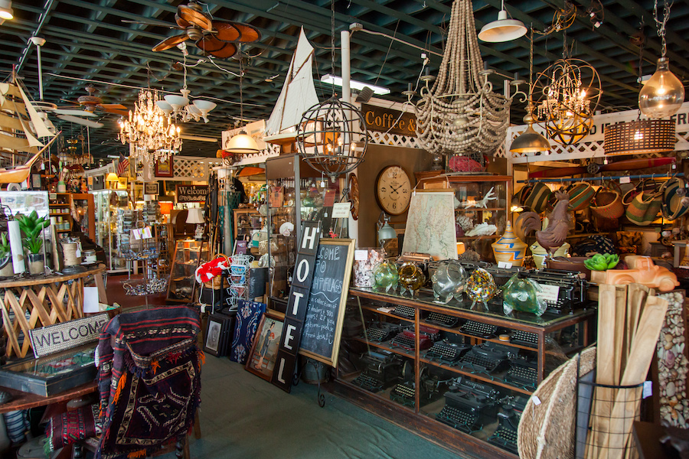
Notes:
Antique store

Slide 19

Notes:
Seth Rogen

Slide 20
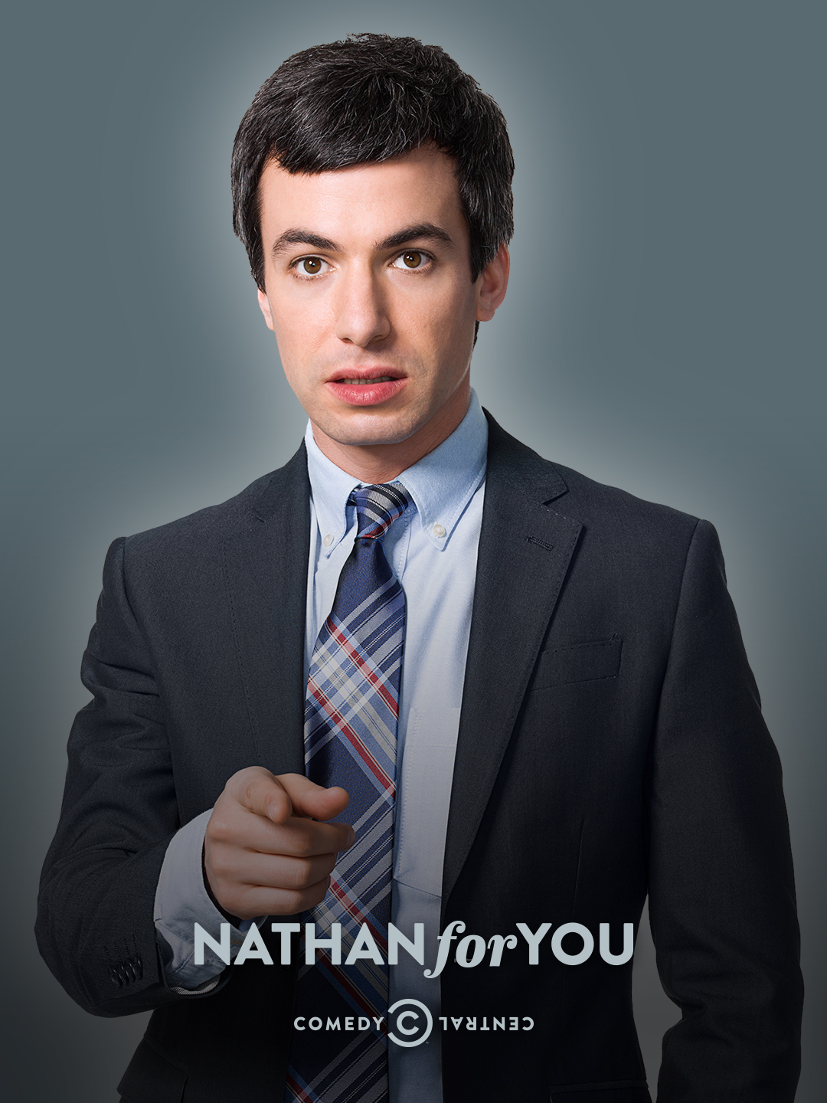
Notes:
Nathan for you

Slide 21
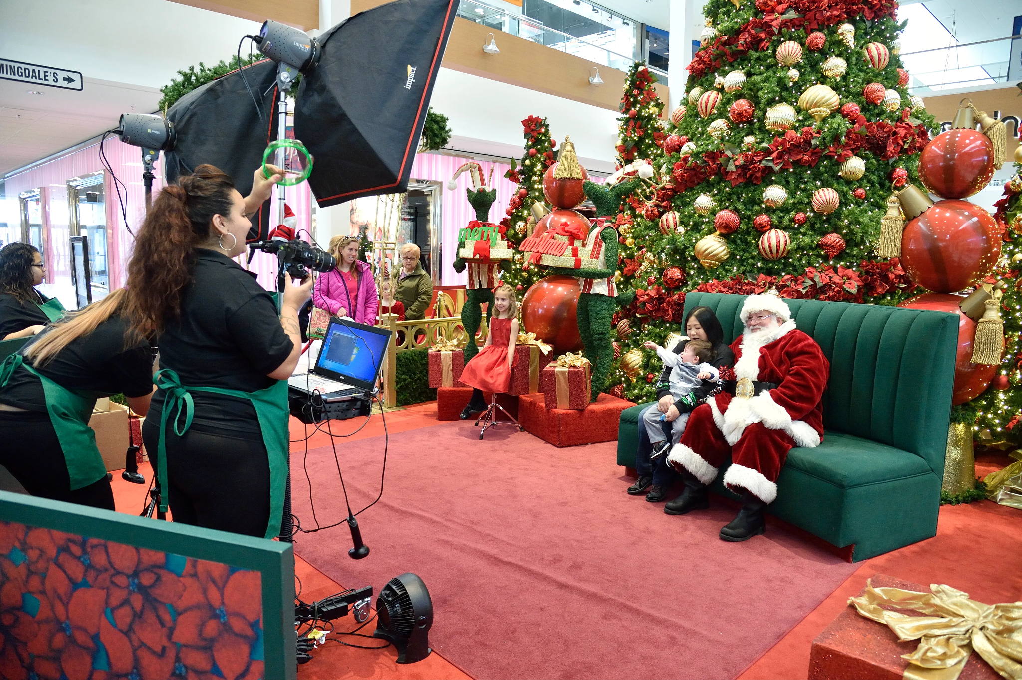
Notes:
Mall Santa

Slide 22
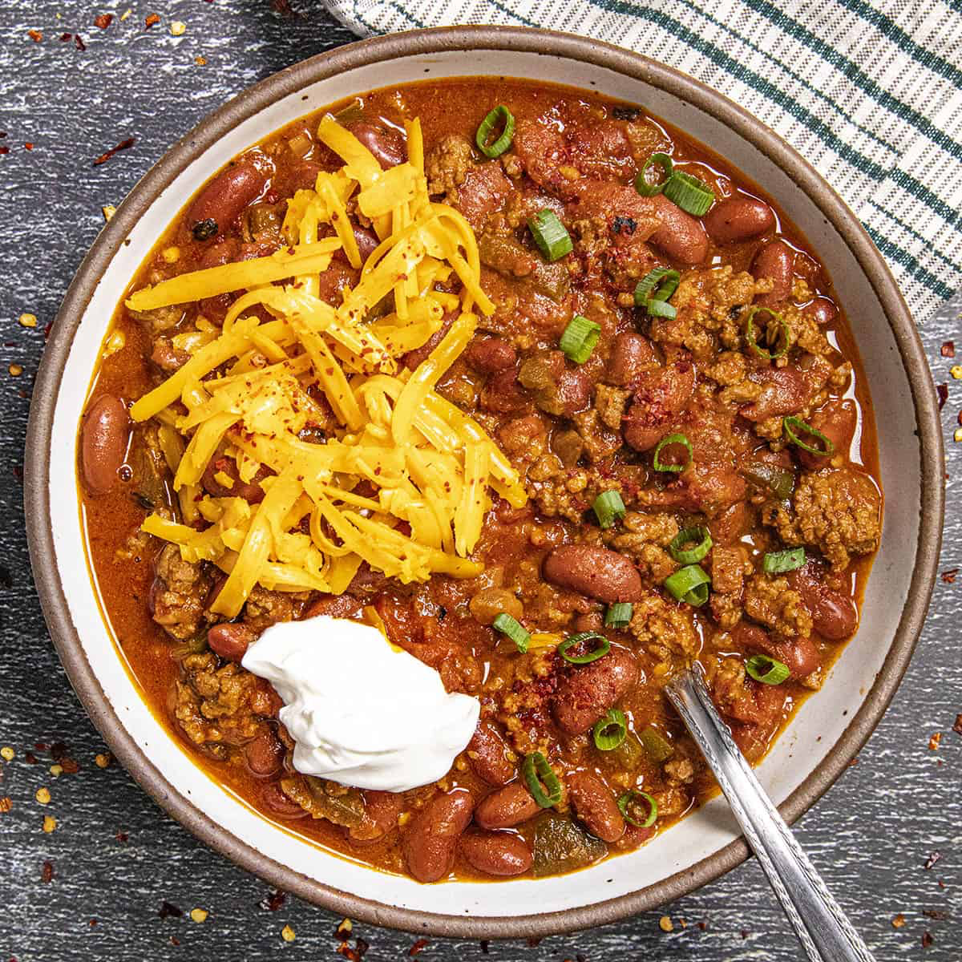
Notes:
chili

Slide 23

Notes:
Paramount Plus

Slide 24
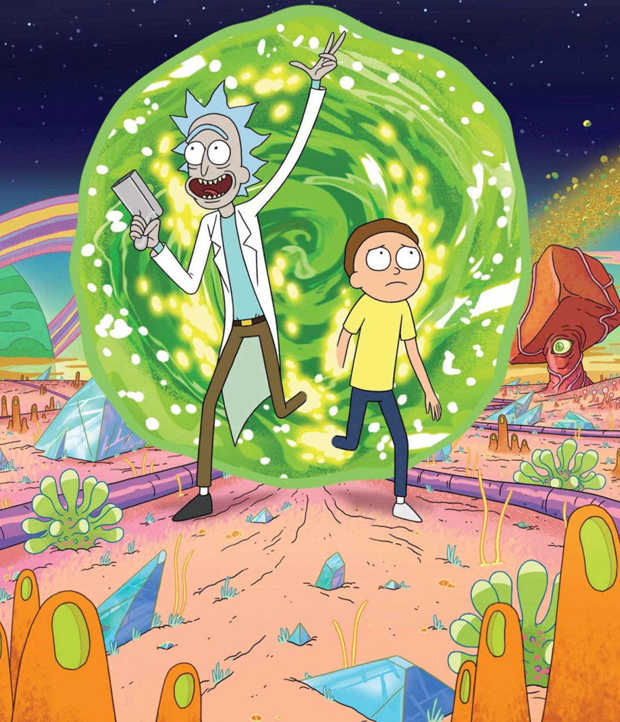
Notes:
Rick and Morty

Slide 25
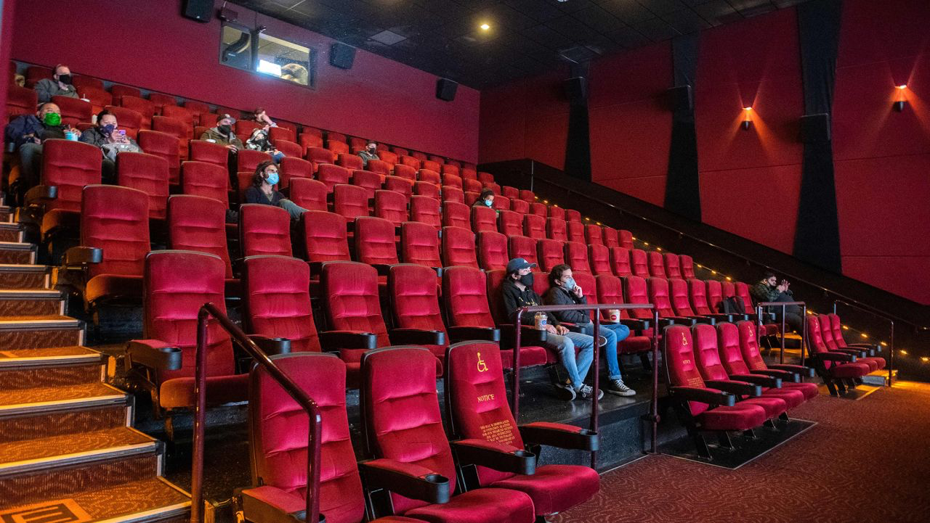
Notes:
Movie theater

Slide 26
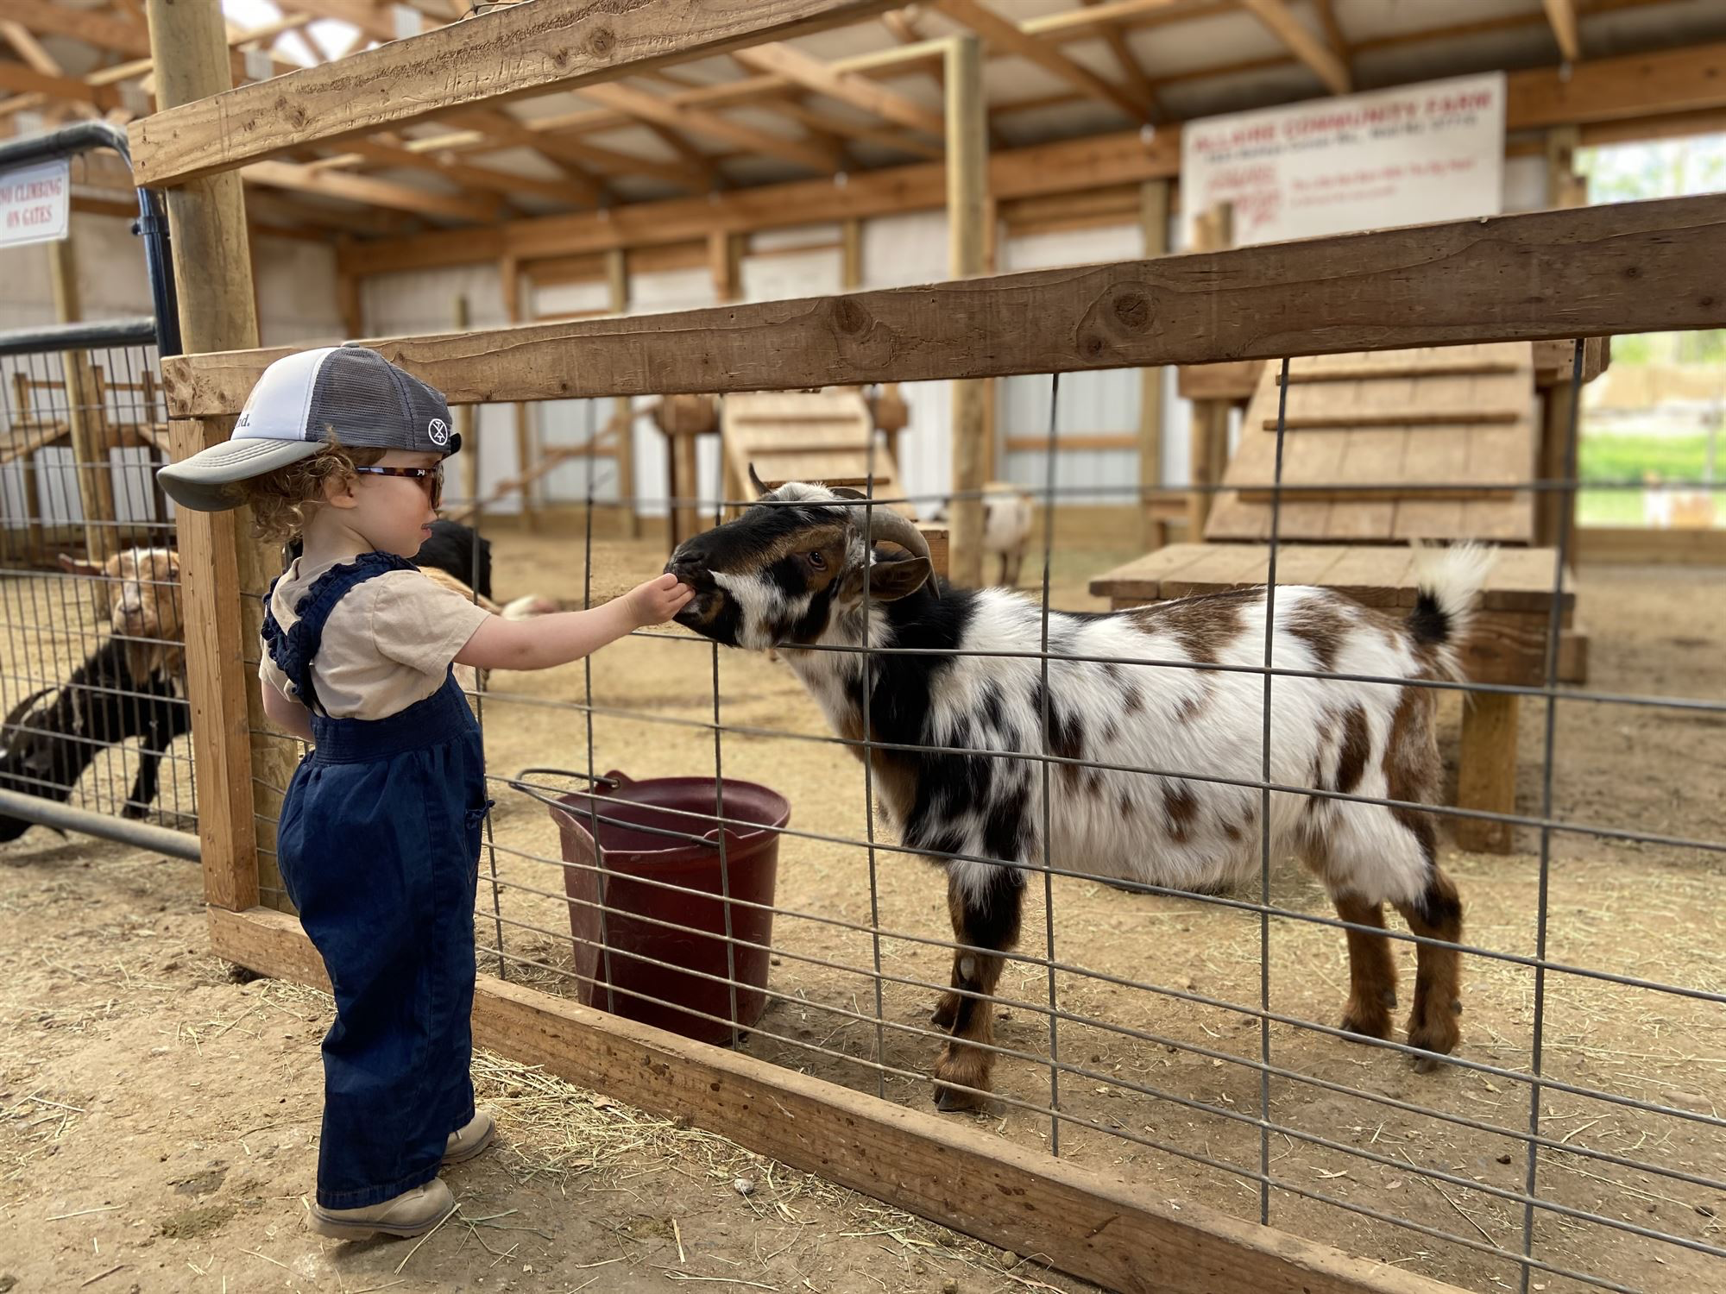
Notes:
Petting zoo

Slide 27
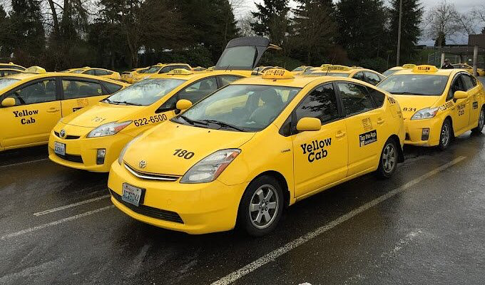
Notes:
taxi

Slide 28
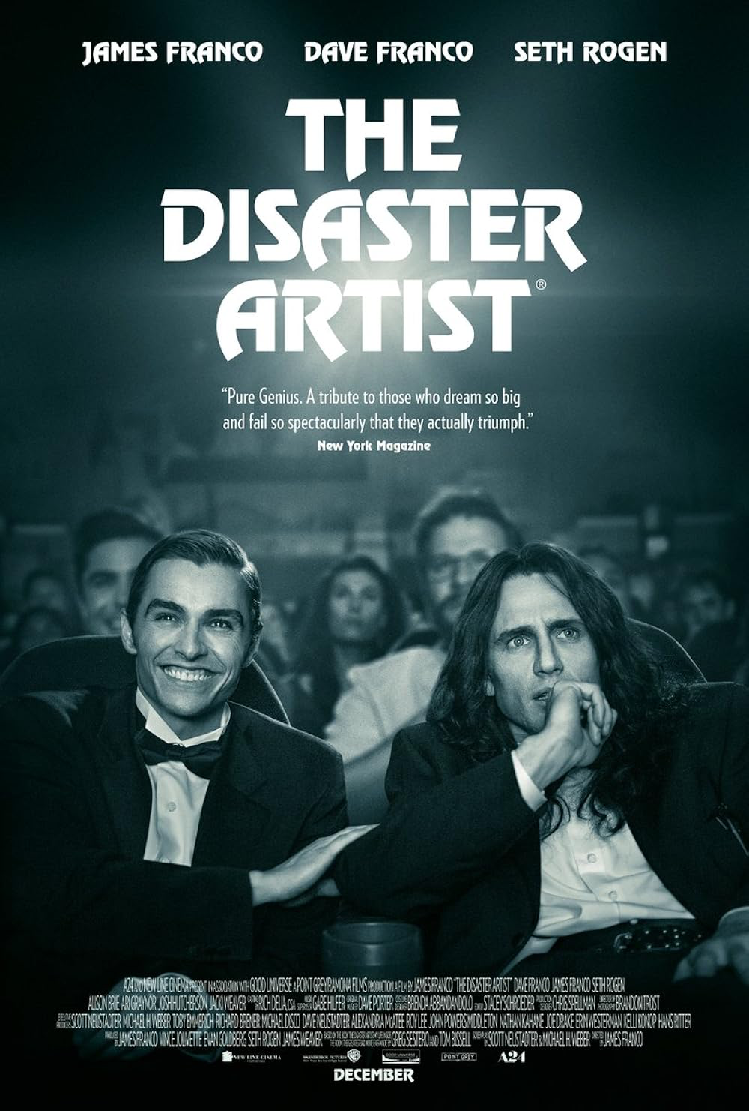
Notes:
The Disaster Artist

Slide 29

Notes:
Canadian Idol

Slide 30
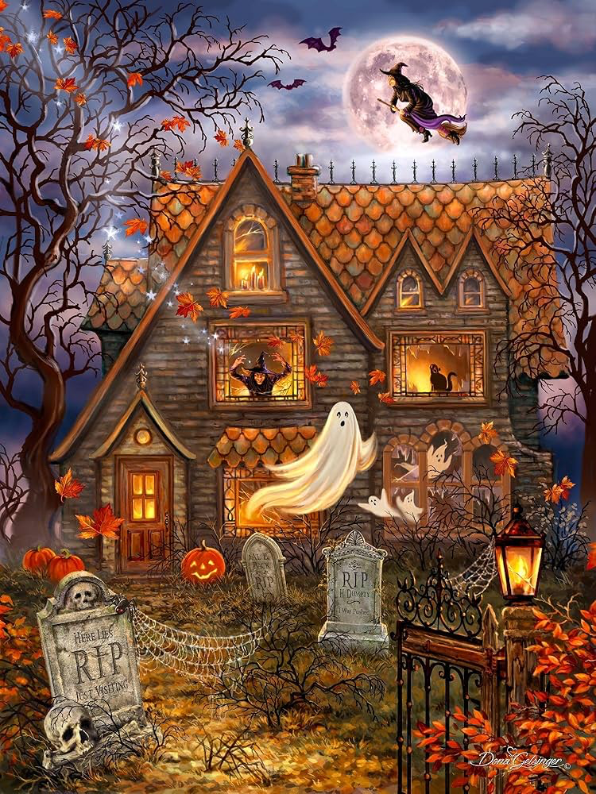
Notes:
Haunted house

Slide 31

Notes:
Comedy Central

Slide 32
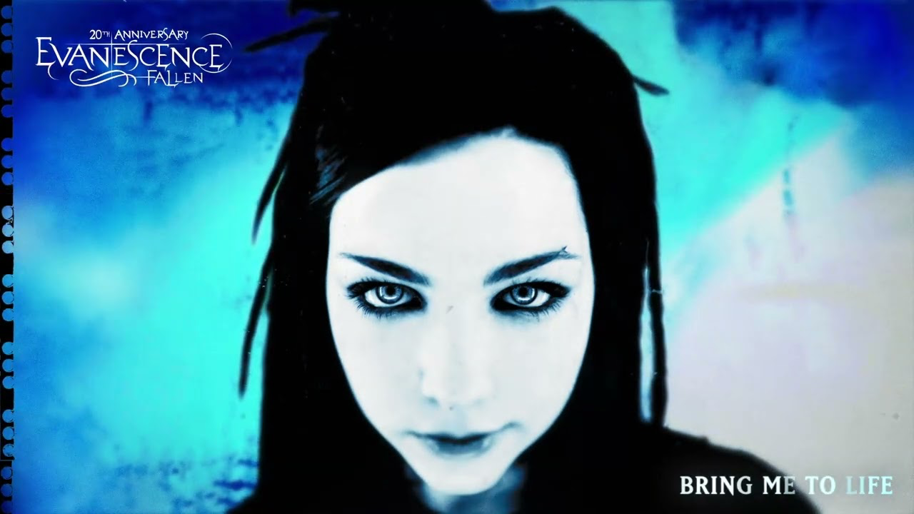
Notes:
Evanescence

Slide 33
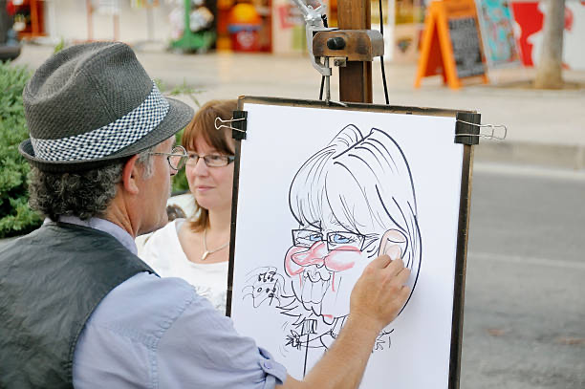
Notes:
caricature

Slide 34
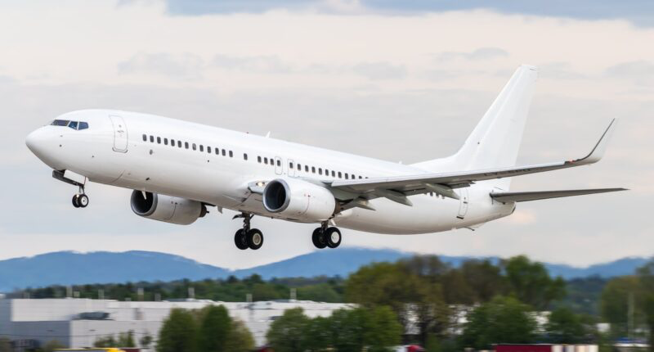
Notes:
Boeing 737

Slide 35
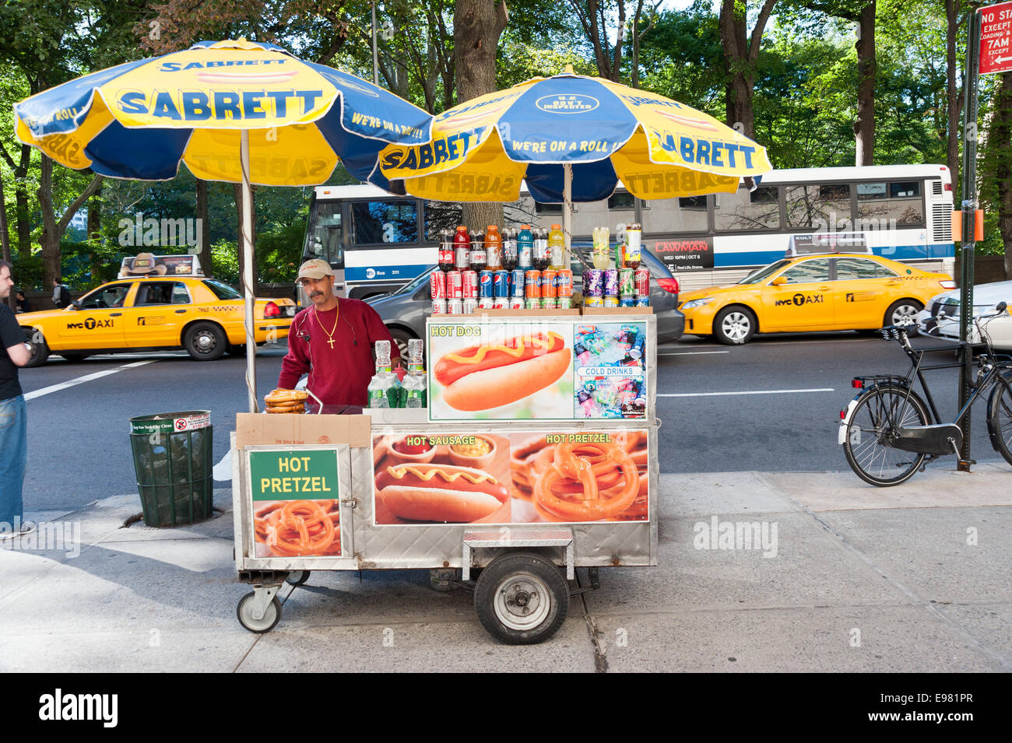
Notes:
Hot dog stand

Slide 36

Notes:
Smoke detector

Slide 37
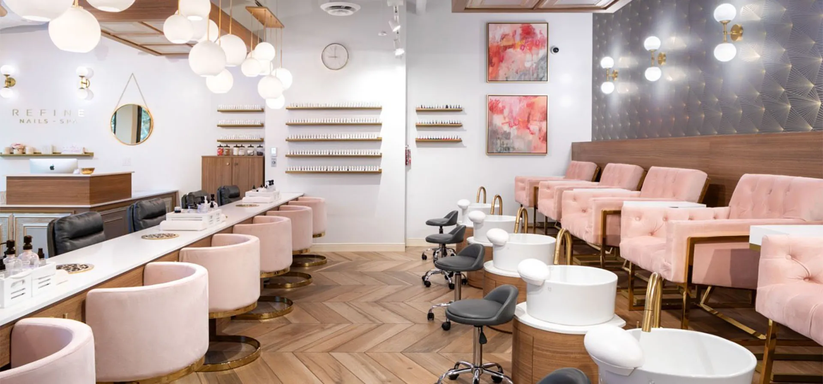
Notes:
Nail salon

Slide 38

Notes:
The Movement

Slide 39
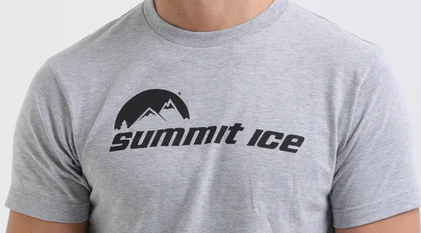
Notes:
Summit Ice

Slide 40
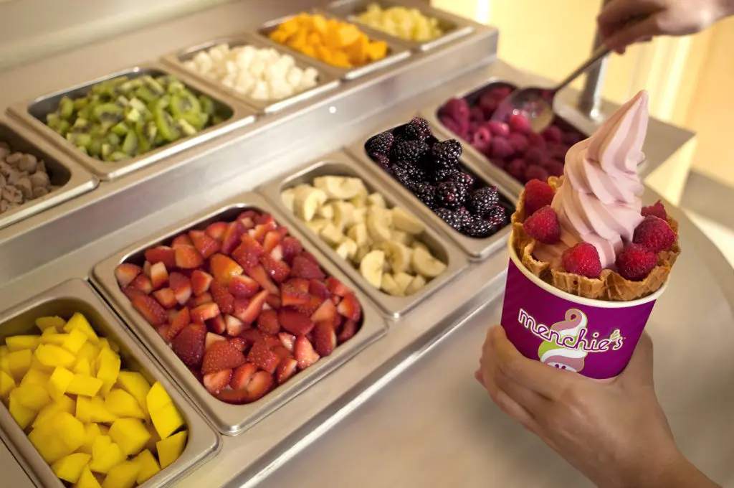
Notes:
Frozen yogurt

Slide 41

Notes:
CBC (canadian broadcasting corporation)

